Slide 1

Tracking Student Journey: Analyzing Retention and Graduation Rates
Team 4

Slide 2






UCONN Capstone Project Team
Bajram Lumani
Project Manager
Shriya S M
Sponsor Liaison
B V S L Saikrishna
Technical Lead
Rohit Reddy M
Data Analyst
Siva Sobhan Prabhala
Data Scientist
Deepak Pasala
Business Analyst

Slide 3

Agenda
Business Problem
Initial Approach
Data Exploration
Model Comparison
Visual Analysis
Recommendations
References

Slide 4
Business Problem
UConn is a prestigious university with a global reputation for quality education and academic success. The reputation of all UConn campuses hinges on student graduation and retention, making it a highly competitive institution.
Problem:
UConn's undergraduate program needs improvement in retention and graduation rates.
Retention and graduation rates are crucial indicators of institutional effectiveness and student success in higher education.
Continued low attrition and graduation rates pose a risk to the university's reputation and national rankings.
Students may not receive the full value of their tuition if these rates do not improve.
Proposed Solution:
Develop strategies to improve UConn’s retention rates
Addressing key attrition factors
Provide key insights into increasing the retention rate.
Developing a machine learning model to predict student retention.

Slide 5
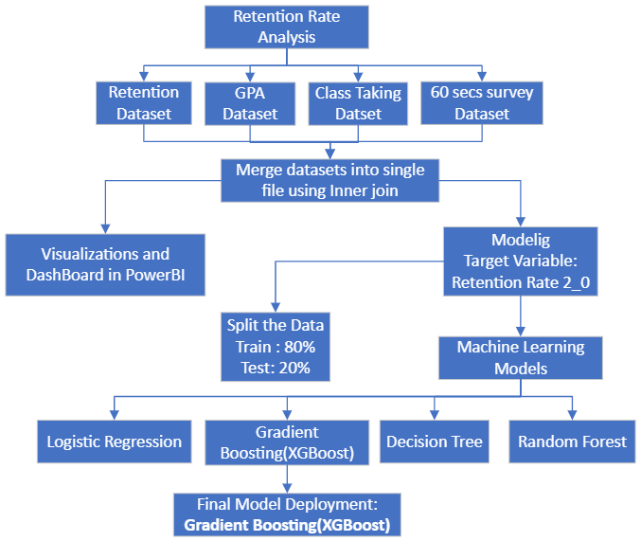
Initial Approach (Our Data Analysis Flow Chart)

Slide 6
Data Exploration
SEMMA [Sample, Explore, Modify, Model, Assess]
Data Merging:
The utilization of an inner join facilitates the merging of disparate datasets, bringing them together into a consolidated single dataset.
With 991,849 rows and 23 columns in the class-taking data, the presence of 51,595 unique dummy IDs, averaging 19 records per ID, poses redundancy issues during dataset merging. To address this, the table is pivoted based on dummy IDs, and the fields are populated with counts, resolving redundancy by representing instances where the same dummy ID has identical grades across different subjects.
To address redundancy in the sixty-second survey data with numerous duplicate dummy IDs, we utilized the groupby function, grouping the data by dummy ID. Taking the mean of each dummy ID's values across all columns, we obtained a single value for each ID, effectively eliminating redundancy in the dataset.
Due to the presence of 6,175 unique IDs in the Q_center sign-ins dataset, merging it with the retention dataset would result in a substantial loss of data, accounting for 75%. Consequently, we opted to exclude this dataset from the analysis to maintain data integrity.
Notes:
Can remove fpr final

Slide 7
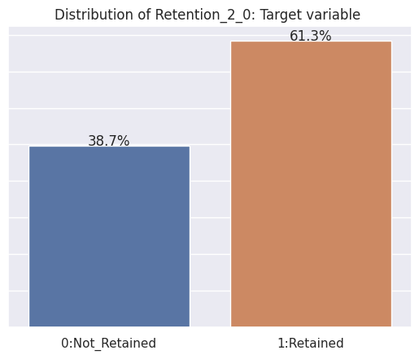
SEMMA [Sample, Explore, Modify, Model, Assess]
Data Exploration
Sample the data : After the Fall 2023 semester, there will be no need to consider retention data as the students will be graduating, making it advisable to exclude this information from the analysis.
Target Variable : Retention_2_0
Data Splitting : We've divided the data into two parts, with 80% allocated for training and 20% for testing. This allows us to build and evaluate our model effectively.
Models:
We've applied various machine learning models, including logistic regression, decision trees, gradient boosting, and random forests, to our data for analysis and prediction. This approach helps us explore different methods and select the one that best suits our objectives.
Performance Metrics:
Accuracy
Precision
F1 Score

Slide 8
Final Model Deployment
SEMMA [Sample, Explore, Modify, Model, Assess]
Gradient Boosting demonstrates the highest performance across multiple evaluation metrics, showcasing superior accuracy, precision, recall, and F1-score compared to other models.
Random Forest show slightly lower but comparable performance to "Gradient Boosting," excelling in accuracy, precision, and F1-score.
Decision Tree and Logistic Regression displays lower values across all metrics, indicating relatively lower predictive capability compared to the other models.
Final model
The slight differences in performance metrics highlight "Gradient Boosting" as the best-performing model, closely followed by "Random Forest" while "Decision Tree" and “Logistic Regression” shows the least robustness in predicting student retention

Slide 9
SEMMA [Sample, Explore, Modify, Model, Assess]
Gradient Boosting Model Column Contributions
for Retention
The top 10 feature importance columns collectively contribute to nearly 79% of predictive power.
Pell Grant holds the highest position, contributing significantly at 26.60%, underscoring its pivotal role in outcome prediction.
Student Organization follows closely, representing 12.74% of the contribution, highlighting the influential role of extracurricular involvement in predictions.
Academic Confidence is a key factor, contributing 6.01%, indicating the impact of self-assurance on predicted outcomes.

Slide 10
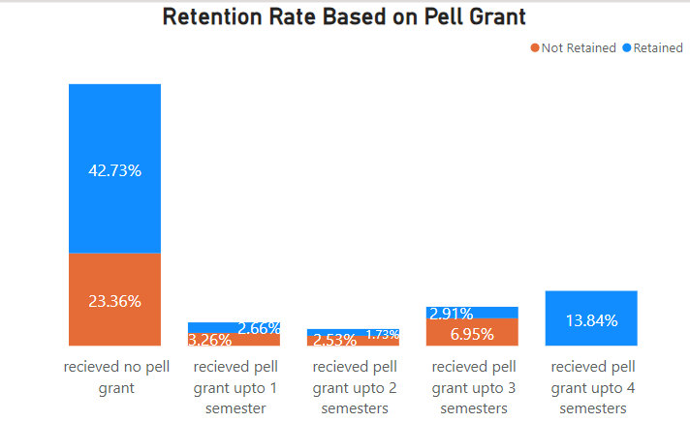
Visual Analysis Retention Rate vs Pell Grant
Insights
Our focus should shift to students not receiving Pell Grants, as this is the area where we have the opportunity to enhance the retention rate, which currently exhibits a higher percentage
Each student not receiving Pell grants for up to 4 semesters corresponds to a retention rate of 2 students.
Conversely, for every student receiving Pell grants for up to 3 semesters, there is an attrition of 2.5 students who are not retained.
Students receiving Pell grants for up to 4 semesters exhibit a 100% retention rate, with all of them successfully retained.

Slide 11
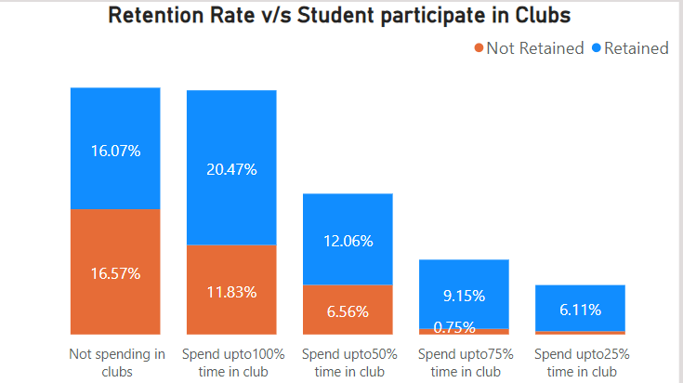
Visual Analysis Retention Rate vs Student_Org
Insights:
Direct our attention to students not engaged in clubs, aiming to boost retention rates given the observed higher non-retention rate in this group.
Students who are spending at clubs have a higher retention rate of (64%) compared to those not involved in clubs as (36%).
Even spending a small amount of time in clubs (up to 25%) increases the retention rate compared to non-participation.

Slide 12
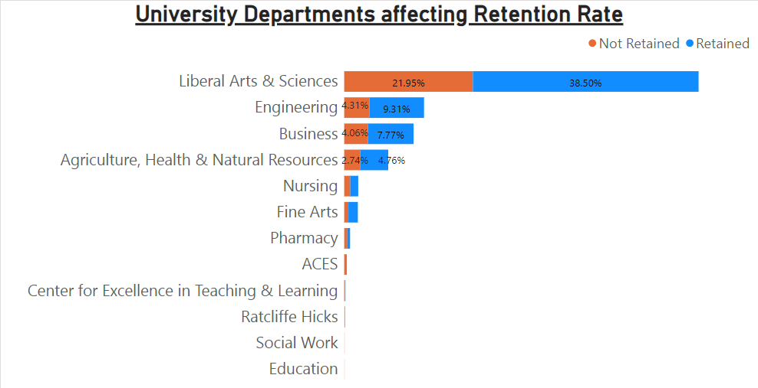
Visual Analysis Retention Rate vs Departments
Insights:
The graph indicates a combined retention rate of 17% for Engineering and Business Programs, signifying a substantial decline in the number of students from these departments.
UConn should prioritize Retention on departments such as ACES, Center for Excellence in Teaching & Learning, Radcliffe Hicks, Social Work, and Education, as they exhibit nearly a 100% non-retention rate.
The Liberal Arts & Sciences department plays a pivotal role in student retention, offering an opportunity to elevate the overall retention rate
12

Slide 13
Business Recommendations
Addressing Retention Challenges Through Financial Support Solutions:
Our analysis reveals that approximately 36% of students face retention issues, even with Pell grants in place. To enhance retention, we propose the implementation of on-campus part-time employment opportunities.
Once a student has received one Pell Grant, university should focus on providing other supports, such as academic advising and financial counseling, to help them stay in college and complete their degrees.
This initiative aims to provide students with financial support, alleviating stress and fostering a conducive environment for their academic success.
Strategic Recommendations for Improving Retention Rates Through Students engagements in clubs etc.
Offering a wide variety of clubs and organizations to meet the needs of all students.
Allocating funds to the clubs can bring more participation of students can show positive growth in Retention Rate
Recognizing and rewarding students for their involvement in clubs.
By supporting student participation in clubs, schools can help to improve their retention rates and ensure that more students are able to graduate and achieve their educational goal

Slide 14
Business Recommendations
Guiding Strategies for Students Encountering Academic Challenges within their Departments
UConn should prioritize Engineering and Business Programs due to their high demand in the current market.
Advertise UConn's unique curriculum, graduation rates, and placement statistics for these programs to enhance the retention rate.
Conduct monthly podcasts featuring UConn alumni to guide students after their first year, facilitating engagement and skill development.
Focus on improving the retention rates especially in the specific departments—ACES, Center for Excellence in Teaching & Learning, Radcliffe Hicks, Social Work, and Education—to reduce the financial burdens on UConn.
Guarantee Pell Grants or financial assistance for all students willing to join, aiming to enhance the retention rate in these 5 departments.

Slide 15
References
Coleman, M. (2022, April 19). HOW MENTAL HEALTH IS IMPACTING STUDENT RETENTION. Retrieved from The National Society of Leadership and Success: https://www.nsls.org/
David H. Kalsbeek, C. M. (4 Ps of Student Retention Framework). Improving Outcomes through the. DePaul University.
Fuerst, N. (2022). 2021/2022 Annual Report on Retention and Graduation. University of Connecticut.
Fuerst, N. (2023). 2022/2023 Annual Report on Retention and Graduation. University of Connecticut.
Nietzel, M. T. (2022, Dec 13). New Report: College Completion Rates Improve, But Disparities Remain A Problem. Retrieved from Forbes: https://www.forbes.com/sites/michaeltnietzel/2022/12/13/new-report-college-completion-rates-improve-but-disparities-remain-a-problem/?sh=a59246e59e55
Nieuwoudt, J. E. (n.d.). https://journals.sagepub.com/doi/10.1177/1521025120985228.
Nieuwoudt, J. E. (n.d.). Sage Journals Home. Retrieved from Student Retention in Higher Education: Why Students Choose to Remain at University: https://journals.sagepub.com/doi/10.1177/1521025120985228
University, W. (2023, May 29). Student Retention Strategies. Retrieved from Wiley University Services: https://universityservices.wiley.com/student-retention-strategies/

Slide 16

THANK YOU….!!

Slide 17
APPENDIX

Slide 18

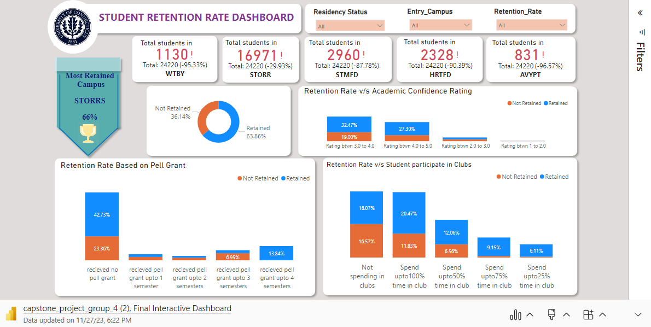
INTERACTIVE DASHBOARD
Click here to view online Dashboard

